Slide 1

Welcome to the 4TU Git Workshop

Slide 2
Program for today
10:00-12:30 – Unix shell
11:30-11:45- Break
12:30 – 13:30 – Lunch
13:30- 17:00 Git
14:30 – 14:45 Break I
15:45- 16:00 Break II
17:00 End of the workshop. Day 1

Slide 3
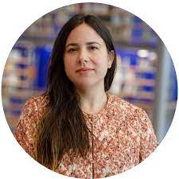
The team of the workshop
Instructor : Leila Inigo de la Cruz
Trainer at 4TU.ResearchData

Slide 4
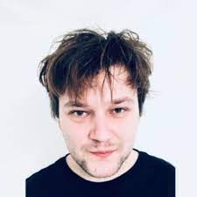
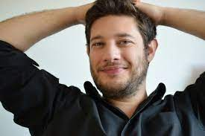
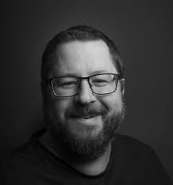
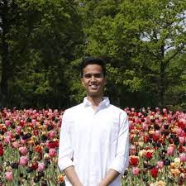
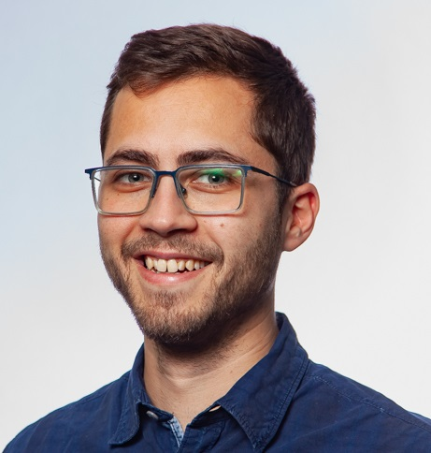
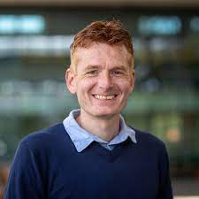
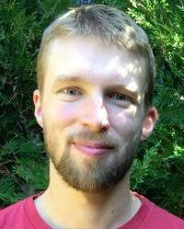
The team of the workshop
Samuel
UT-Lisa
Elvis
TU Delft
Helpers:
Joao
TU Delft
Halford
TU Delft
Jay
UT-ITC
John
TU/e
Bjorn
TU Delft

Slide 5
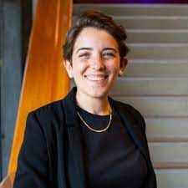
The team of the workshop
Host: Alessandra Soro
Community Manager at 4TU.ResearchData

Slide 6




The team of the workshop
YOU!

Slide 7

Code of conduct
The Carpentries teaches foundational coding, and data science skills to researchers worldwide.
Use welcoming and inclusive language
Be respectful of different viewpoints and experiences
Gracefully accept constructive criticism
Show courtesy and respect towards others during the workshop

Slide 8

Ice breaker
Write in the chat: the name of your university and what you like the most about it?

Slide 9
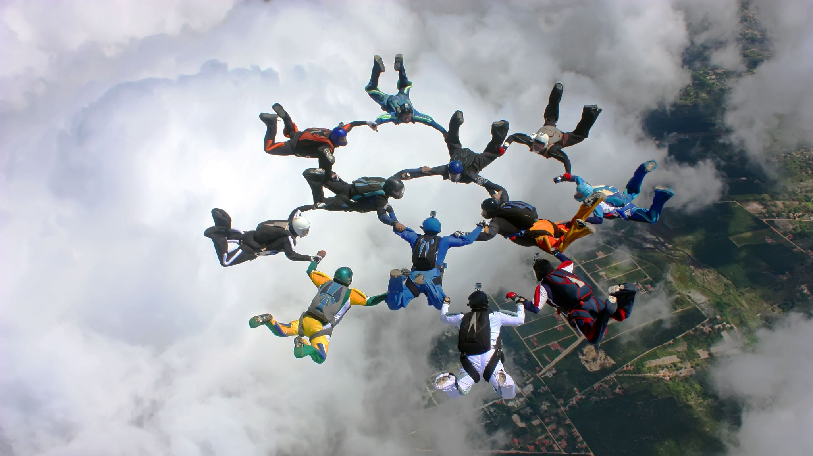
Enjoy!

